Slide 1
Membership Management Software with RFID based Login (Phase 1)
Nakul Khadilkar

Slide 2
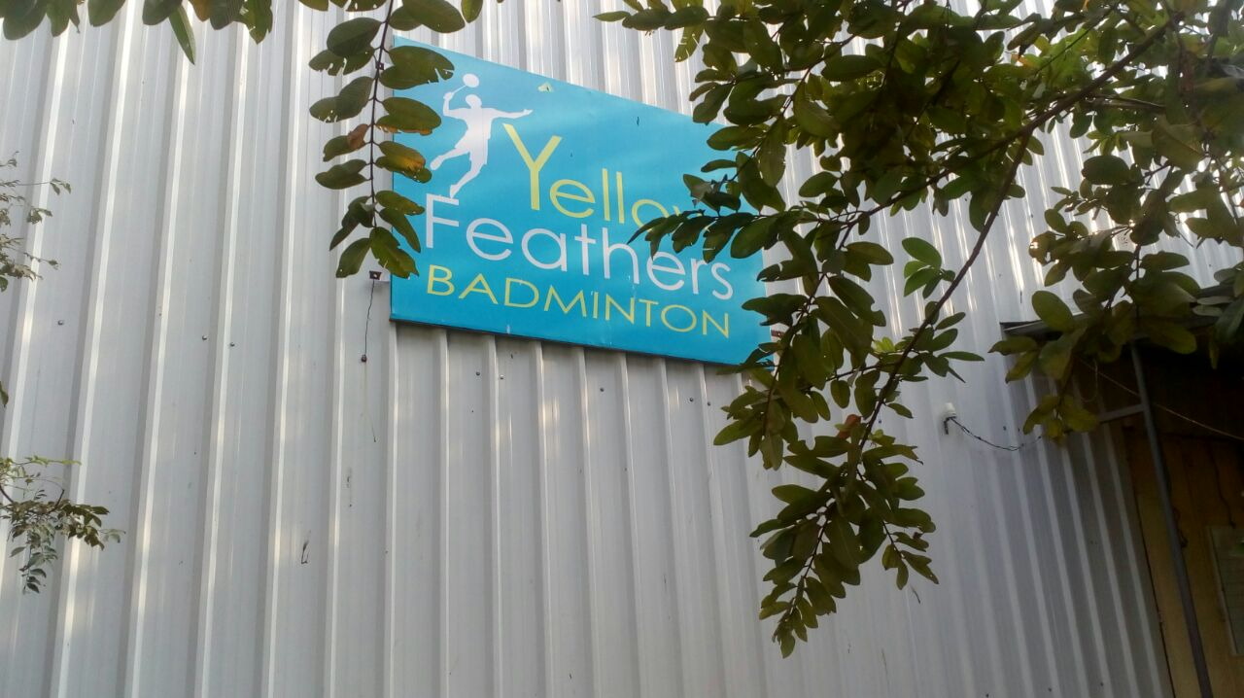
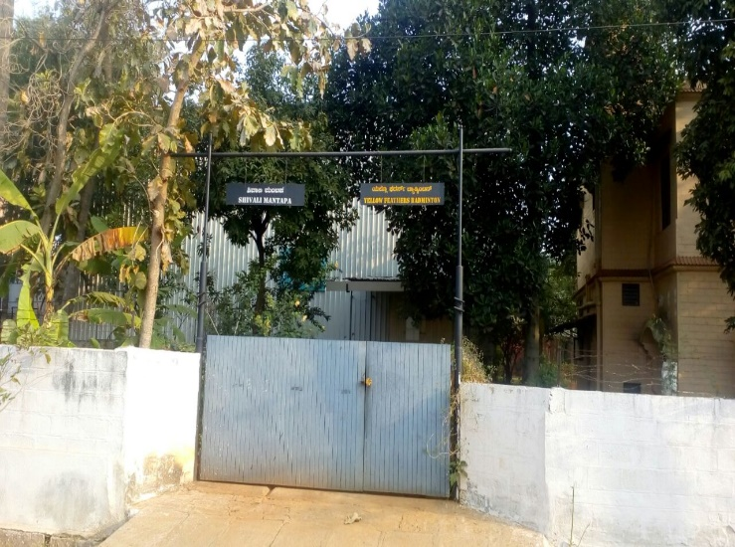
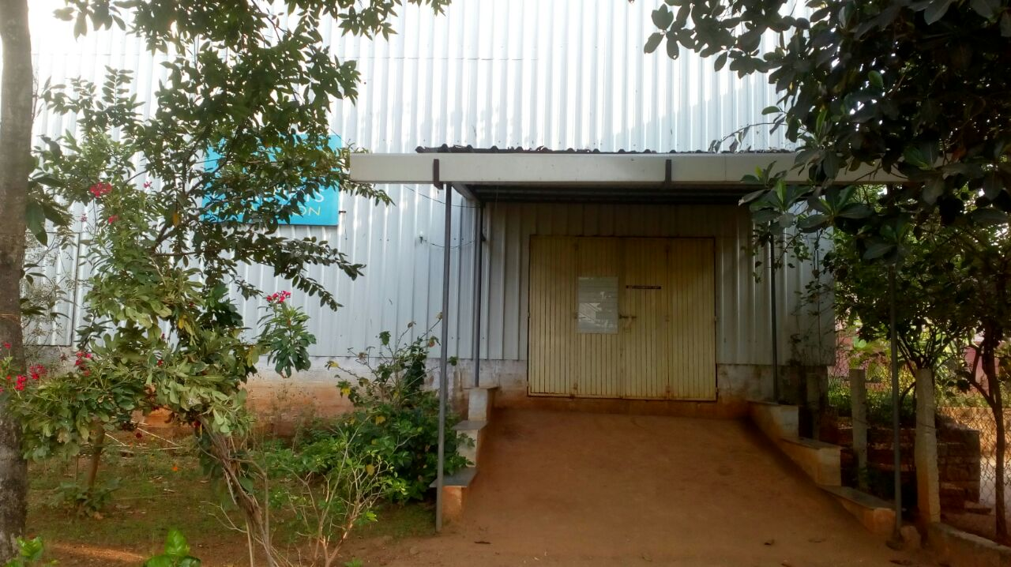
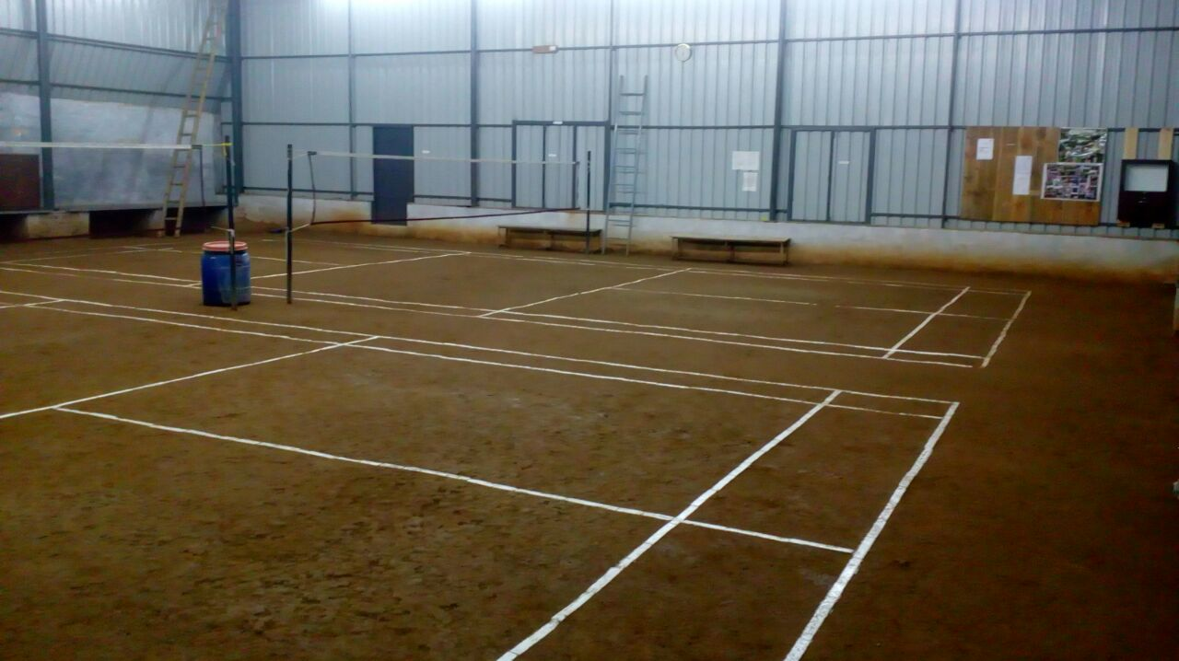
About Yellow Feathers Badminton Club (YFBC)
Location : Bengaluru, India
Started small
4-8 people who played regularly outdoors
Mostly a social venture to get people together and enjoy the game while breaking sweat
Expanded operations in 2017 following interest from people
Built an indoor facility
Extended membership options
Started fee-based structure
Remote monitoring using a WebCam

Slide 3
Motivation and Requirements for the Membership management software
Challenges
Hassle to maintain paper records with increased members
Time-consuming to keep track of the payments made and alert members for dues
Tough to communicate to members unless we had their personal information on paper
Requirements
Low cost
Ability to integrate with external hardware (RFID, door lock, webcam, etc)
Minimal dependence on an internet connection
Simple, yet intuitive
Easily accessible database

Slide 4
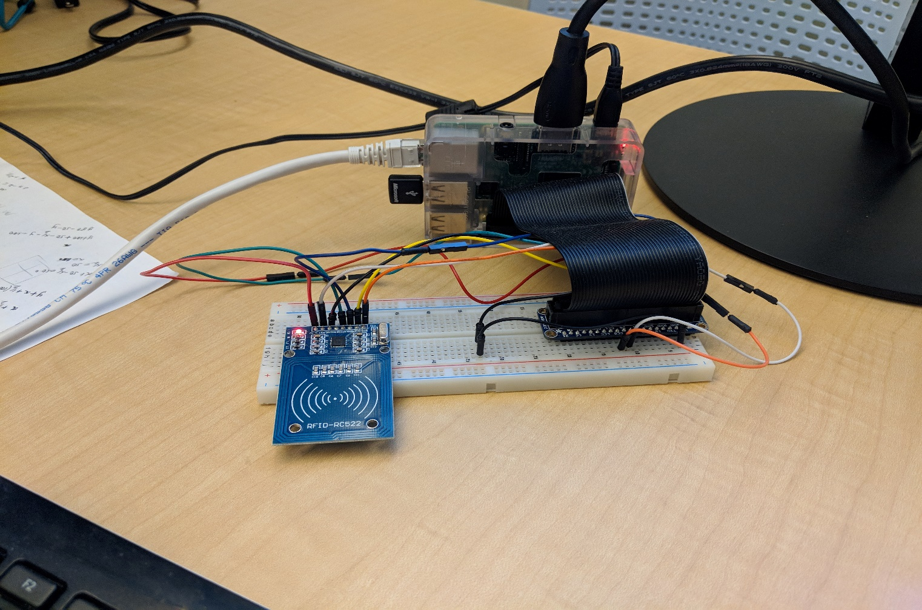
Overview
Hardware
Raspberry pi 3
MFRC522 RFID card reader
Fobs/cards for members
Integrated door lock (TODO)
WebCam access (someday)
Software
Language : Python
Libraries
Tkinter
Other open source libraries for the MFRC522 RFID module
GitHub repository
https://github.com/nakulkhadilkar/YFBC

Slide 5
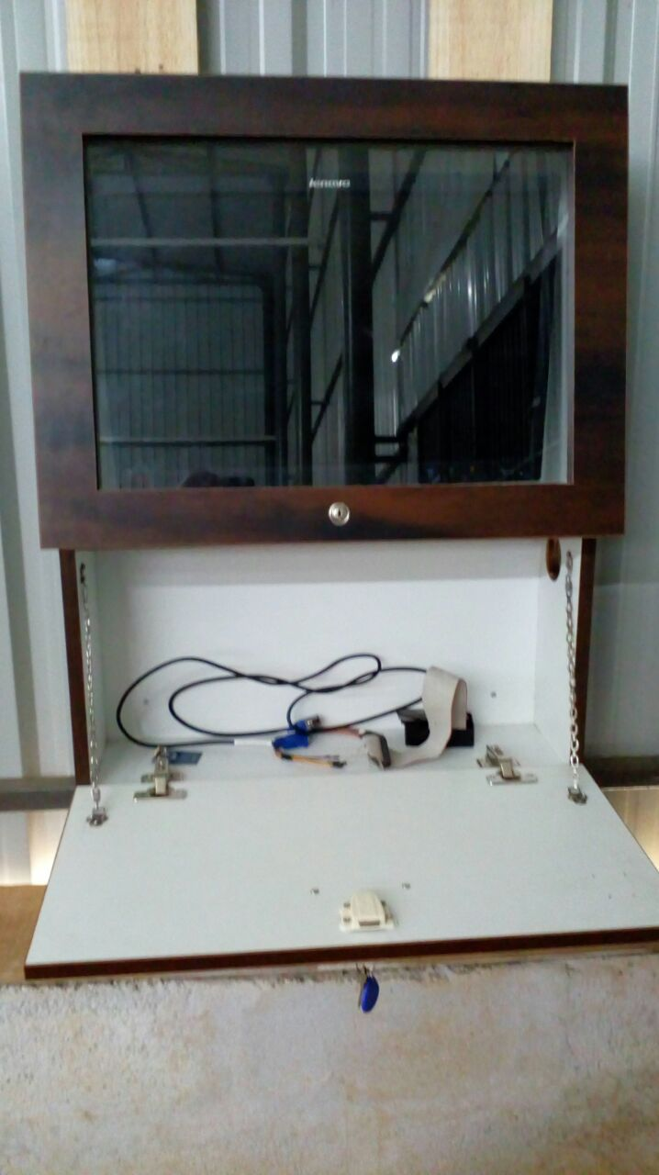
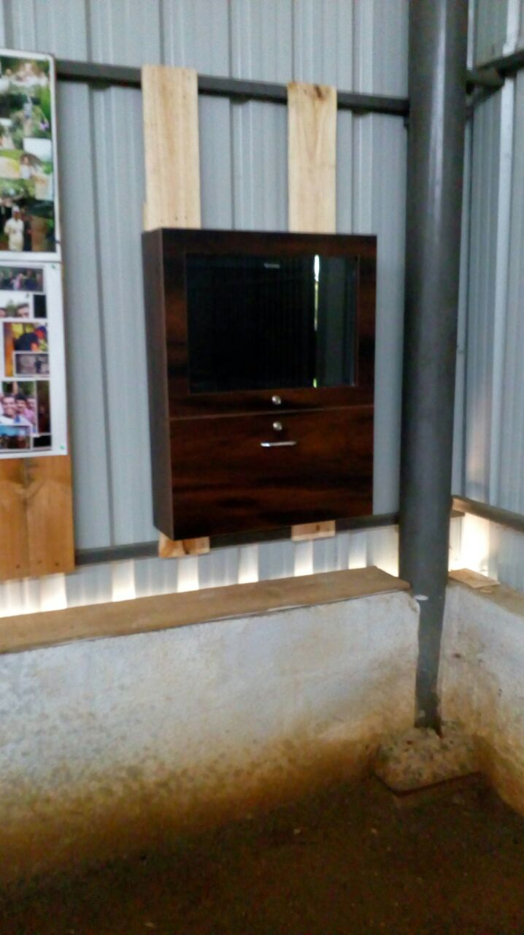
Overview
Hardware
Raspberry pi 3
MFRC522 RFID card reader
Fobs/cards for members
Integrated door lock (TODO)
WebCam access (someday)
Software
Language : Python
Libraries
Tkinter
Other open source libraries for the MFRC522 RFID reader module
GitHub repository
https://github.com/nakulkhadilkar/YFBC

Slide 6
Implementation Details
The software has the following functionality.
For members
Registration email with details stored
Payment status for monthly members
For Admin
Add/Edit/View member
Payment posting/status check
Upload the data files to cloud storage
Demo

Slide 7
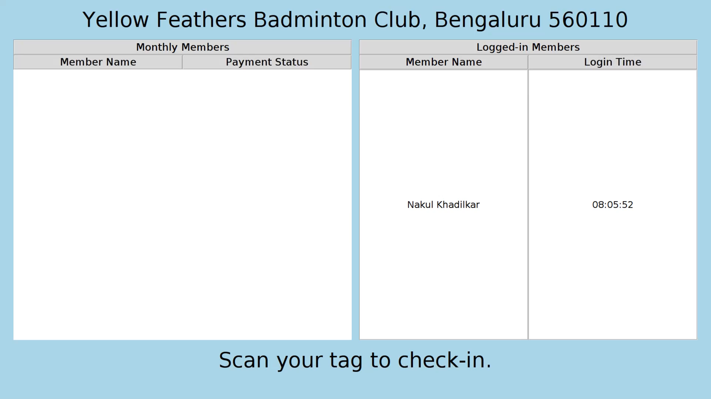
Implementation Details
The software has the following functionality.
For members
Registration email with details stored
Payment status for monthly members
For Admin
Add/Edit/View member
Payment posting/status check
Upload the data files to cloud storage
Demo

Slide 8
Future Work
Integrate the login system with the door lock for access control
Provide the ability to create draws for tournaments within the software
Display slideshows of YFBC related photos when not in use

